Slide 1
MODULE 01: SOFTWARE
REQUIREMENTS
UNIVERSITY OF ALBERTA : CLIENT NEEDS AND SOFTWARE REQUIREMENTS

Slide 2
THREE “RIGHTS” OF
SOFTWARE

Slide 3
○ Understand Right Product
○ Develop Right (Done it Right)
○Manage Right

Slide 4
UNDERSTAND RIGHT PRODUCT
○ The right product means meeting the needs of your clients and end-users and not just their wants.
○ This involves understanding the problem they need to solve, and the tasks they need to accomplish with the software.

Slide 5
○ To achieve done right and managed right, software development must start with a quality set of software requirements, which are later planned, designed, implemented, and tested.

Slide 6
○ Understanding WHY of your client ?

Slide 7
○ In this part of the course, you will learn how to elicit needs from your clients and end-users.You will also learn how to express these needs as a quality set of requirements to initiate software development and planning activities.

Slide 8
WHAT IS REQUIREMENT

Slide 9
INFORMALLY
○A requirement is most easily understood as a specific description of your client’s needs, which can be used to help create a real-world product.

Slide 10
IEEE: FORMAL DEFINITION
○A condition or capability that must be met or possessed by a system or system component to satisfy a contract, standard, specification, or other formally imposed documents.

Slide 11
ACTIVITIES OF REQUIREMENT SPECIFICATION PHASE

Slide 12
ACTIVITIES OF REQUIREMENTS
Eliciting requirements
Expressing requirements
Prioritizing requirements
Analyzing requirements
Managing requirements

Slide 13
ELICITING REQUIREMENTS

Slide 14
ACTIVITIES OF REQUIREMENTS
Eliciting requirements
Expressing requirements
Prioritizing requirements
Analyzing requirements
Managing requirements

Slide 15
○ The activity of eliciting requirements is an interactive and investigative process, which occurs when meeting with the client and users.

Slide 16
WHAT CLIENT KNOWS
○ Clients often have ideas about what features they would like in a product and what these features should look like.

Slide 17
DO NOT EXPECT FROM CLIENT
○Many clients, however, have limited knowledge of how software is built and vague ideas regarding what makes a project successful

Slide 18
YOUR JOB
○ It can be difficult then for clients to understand what they truly require in a product. It is the role of the software product manager to help the client figure out what they “want” and what they “need.”

Slide 19
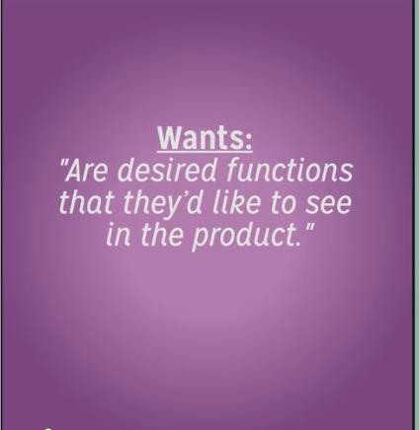
WANTS OF CLIENTS

Slide 20
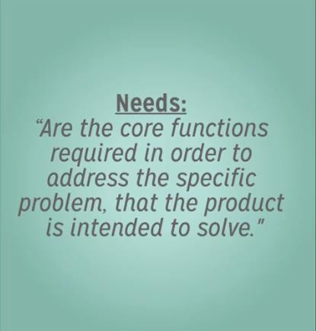
NEED OF THE CLIENT

Slide 21
○ The best way to discover and develop “needs” and “wants” with your client is through eliciting requirements, where you engage in discussion about the product with your client.

Slide 22
IMPORTANT
○Note that eliciting requirements as “needs” and “wants” does not necessarily mean that all the client’s features and ideas that fall in the “want” category are not doable or should be dismissed.
○ That may be excellent but at the
moment not feasible.

Slide 23

BRIDGE THE GAP
○ Understand Why of the client and
tell them WHAT to do

Slide 24
○ Do not mix up Requirement Gathering with Requirement Elicitation.

Slide 25
○ Requirements gathering is the more passive approach of simply asking the client what they would like done, and it often puts the development team in a reactive process. (that is the mistake that software developers mostly do)

Slide 26
○ Eliciting requirements, however, engages in in-depth discussion and collaboration from the start of product development, so both the client and the development team work together to build a successful product.
○ That should be done

Slide 27
EXPRESSING
REQUIREMENTS

Slide 28
ACTIVITIES OF REQUIREMENTS
Eliciting requirements
Expressing requirements
Prioritizing requirements
Analyzing requirements
Managing requirements

Slide 29
○ Expressing the Requirement is process to inform about the elicited requirements to your developer and also verify from the client.

Slide 30
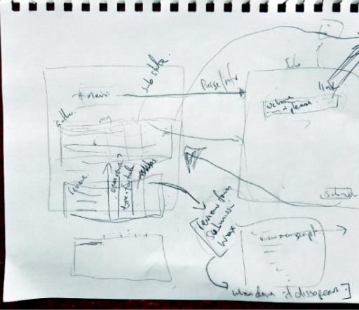
USUALLY REQUIREMENTS START FROM

Slide 31
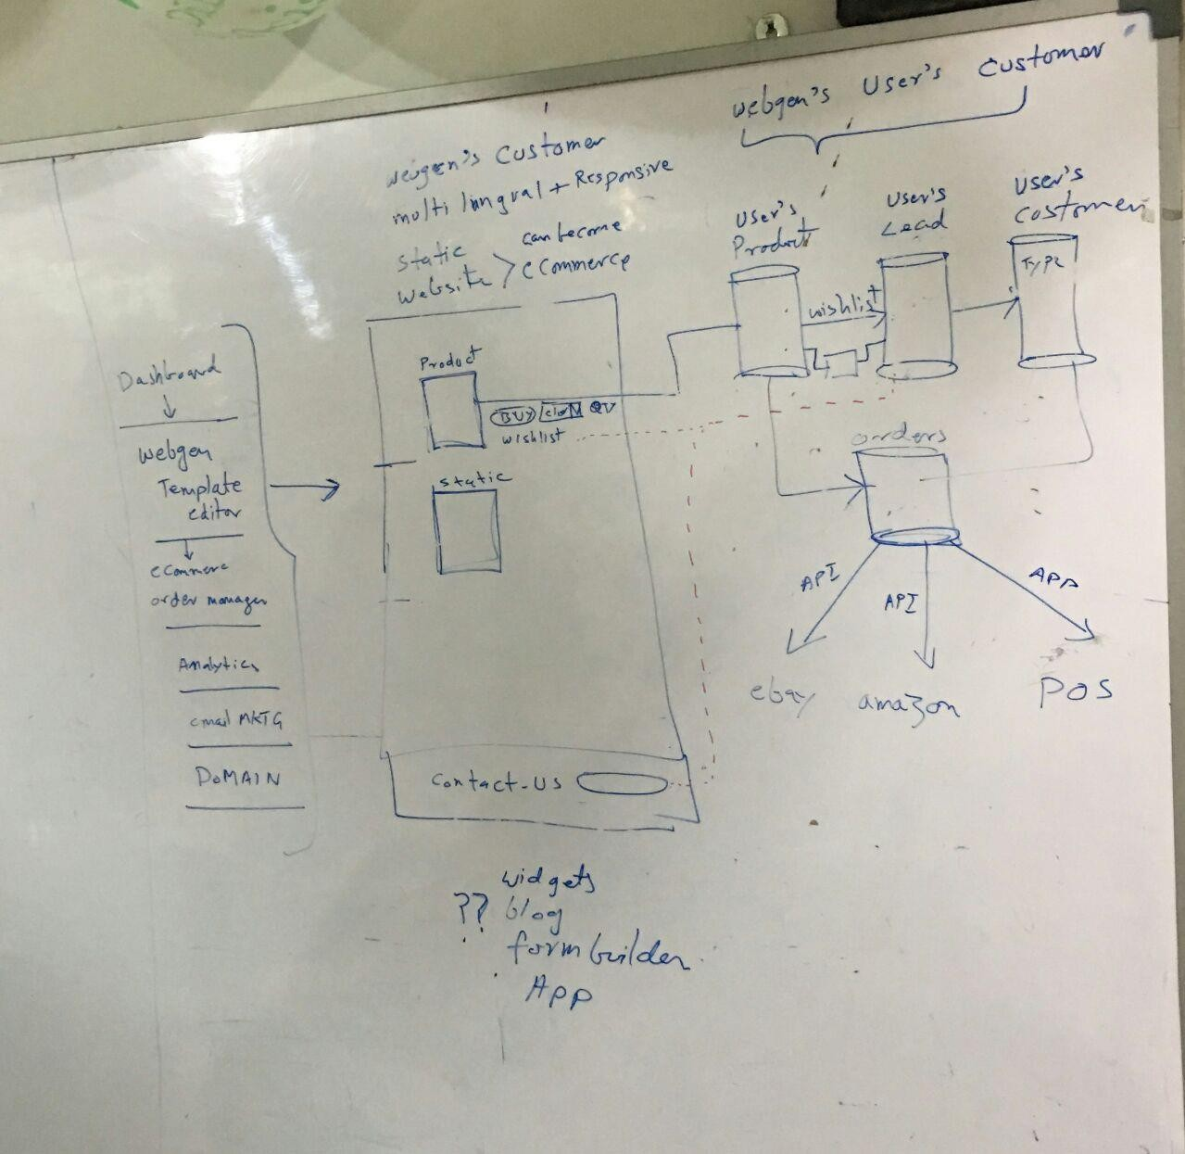
A MORE IT AWARE CLIENT (THAT’S WHAT YOU GET)

Slide 32
○ Different way to express, we shall
see shortly.
EXPRESSING REQUIREMENTS
Writing Requirements in meaningful way
Writing Use Cases
Wire framing
Story Boarding.

Slide 33
PRIORITIZING
REQUIREMENTS

Slide 34
ACTIVITIES OF REQUIREMENTS
Eliciting requirements
Expressing requirements
Prioritizing requirements
Analyzing requirements
Managing requirements

Slide 35
PRIORITIZATION IS IMPORTANT
○ Once a vision of what needs to be done for the project has been established through both eliciting and expressing requirements, it is important to prioritize client needs, especially in Scrum methodology.

Slide 36
QUESTIONS TO HELP ESTABLISH PRIORITIES:
○What requirements must be completed for the project and product to be successful?

Slide 37
QUESTIONS TO HELP ESTABLISH PRIORITIES:
○What could be done to improve the project or product but is not necessary? These priorities are usually only included if both time and resources allow for it.

Slide 38
○What requirements should be done ? In other words, what is important but is not as time-critical or could be satisfied another way or at a later time on the project?

Slide 39
SO PRIORITIZED IN FOLLOWING ORDER
○ MUST BE DONE: Important and
Urgent for success.
○ SHOULD BE DONE: Important
but not Urgent for success.
○ COULD BE DONE: Not Important not Urgent but make the project more attractive.

Slide 40
○Prioritizing is important and critical
for a successful life.

Slide 41
Urgent
Not Urgent
Important
Q1
Important Urgent
Just do it
Q3
Not Important Urgent
Filter it
Q2
Important Not Urgent
Live your life here
Q4
Not Important Not Urgent
Stop doing it
Not Important

Slide 42
ANALYZING THE
REQUIREMENTS

Slide 43
ACTIVITIES OF REQUIREMENTS
Eliciting requirements
Expressing requirements
Prioritizing requirements
Analyzing requirements
Managing requirements

Slide 44
○ The process of examining the listed requirements of a project to ensure that they are clear, complete, and consistent is known as analyzing requirements.

Slide 45
○ Some time we have the requirement those are not consistent with each other. Fulfilling one requirement may disturb other one.
○For example consider following two requirments

Slide 46
CONFLICTING REQUIREMENT
○App should not access the user
messages.
○When confirmation message arrives, the app should automatically read pin code and proceed.

Slide 47
○Analyzing
resolve
requirements
helps to
any potential
conflicting
identify
requirements
or to
problems between requirements that might not be easily seen at first glance.

Slide 48
MANAGING
REQUIREMENTS

Slide 49
ACTIVITIES OF REQUIREMENTS
Eliciting requirements
Expressing requirements
Prioritizing requirements
Analyzing requirements
Managing requirements

Slide 50
○ If something changes in one requirement, it will affect other requirements and the development of the product.
○Managing Requirement allows you To identify the impact of a requirement change.

Slide 51
○Managing requirements also means ensuring that the identified requirements are central to the many processes of product creation, including coding, testing, and change logs.

